Slide 1
FIT5147 Data Exploration and visualisation TP2 2017
Assessment 1 | DataVis Design Exercise
Alen Bednjacic abed10@student.monash.edu Student ID: 10528199 19 March 2017 | Aruna Tillekeratne taru3@student.monash.edu Student ID: 19 March 2017

Slide 2
Brief
Design visualisations to help understand a data set collected by sociologists who are comparing the rates of different types of crimes (i.e., personal crimes and property crimes) in different Victoria suburbs, and exploring how population density, mobility (by looking at the percentage of renting) and the demographic composition (including income, years of education, age composition) affect these.
The collected data set consists of one record for each suburb in Victoria. Each record gives the following suburb profile:
Suburb name: name of the suburb
Postcode & Geolocation: Spatial information about the suburb
Population: Number of residents in the suburb
Area: the area (in square meters) of land in the suburb
Percentage of renting: The percentage of household who are renting in the suburb
Age composition: The percentages of different age groups, e.g., age year 60+, age year 19 - 60, age year 0-19.
Avg. household Income: Average household income in the suburb
Avg. years of education: Average years of education of adult residents in the suburb
Crimes: Besides, each suburb record contains the number of reported personal crimes and property crimes occurred in the suburbs. By personal crime, we refer to “offenses against person/people, e.g., murder, sexual assault, etc.., and for property crime, we mean “offenses against property”: These are crimes that do not necessarily involve harm to another person, for example, Larceny.
This creation and presentation of this assignment follows the Five Design Sheet (FdS) methodology.

Slide 3
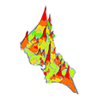
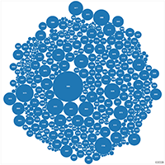

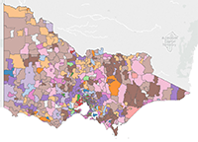
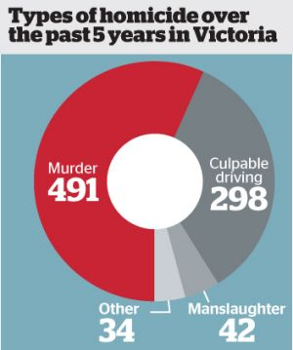
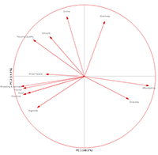
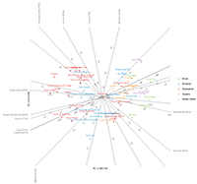
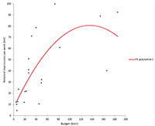
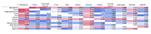
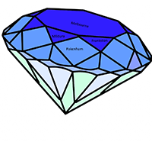
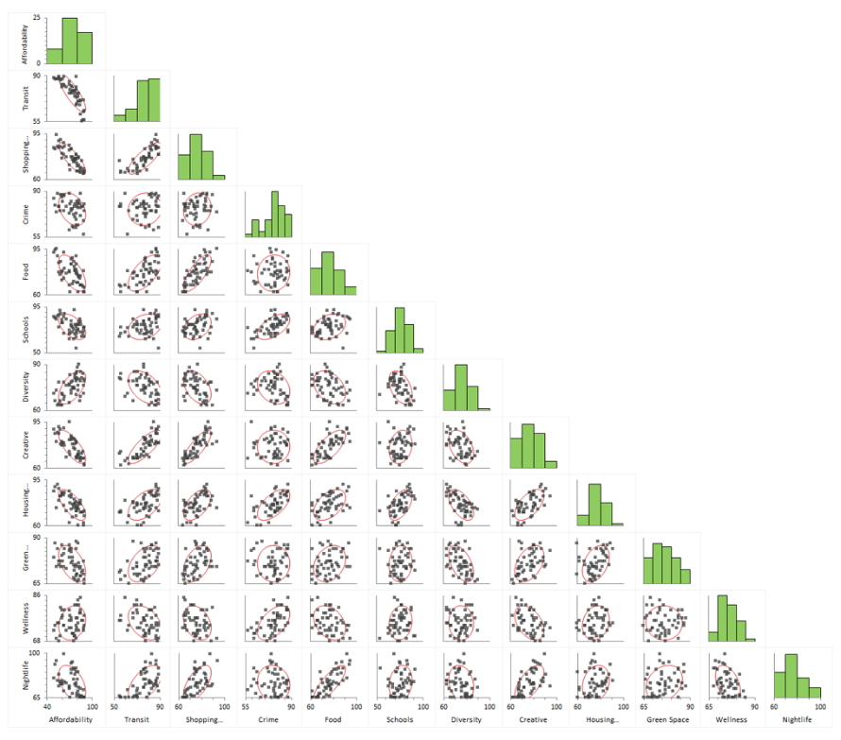
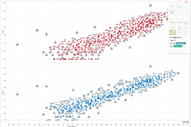
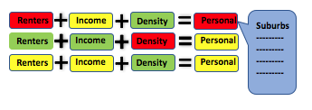
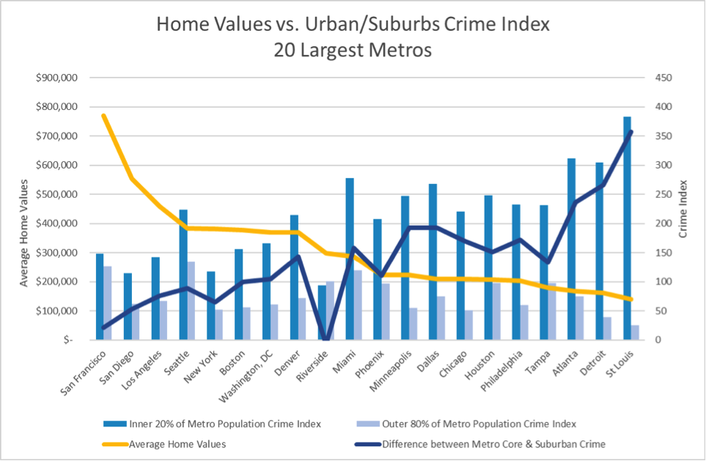
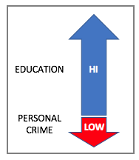
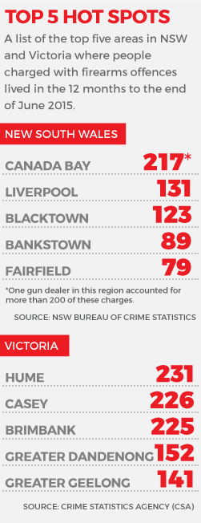
Sheet 1 – The Ideas Sheet
1. Ideas
2. Filter – remove duplicates and unrealistic ideas
1. Map View. | 2. Heat or Contour | 3. Bubble Chart | 4. Segments
5. Crime Radar | 6. Diamond – facets color adjacency and size used to convey data | 7. Evaluate Geo’ distance | 8. Multiple Axes
9. Histograms | 10. Scatter | 11. Correlation Matrix | 12. Outliers View
13. Colour mapped Tables / Pivot Tables | 14. Regression and other Models Plots | 15. Comparison tables | 16. Rank Top & Bottom N
17. Multiple Overlaid Charts | 18. Indicators – HIGH LOW | 19. Select variables | 20. Tabloid / Master Sheet
Remove:
2 Heat and Contour map – data hard to visualise, proximity doesn't correlated to crime levels.
Diamond – suitable for “property crime” less useful metaphor for personal crime
3. Categorise
Specific Charts & Tables
Graphically abstract constructs
Multiple Axes or Composite
Charts
Q & A Controlled
Geo Data
Infolets / Rankings
4. Combine & Refine
C. Multiple Axes / Crime Radar
E. Statistician Mega Worksheet
A. Geographical Visualisation
DATA SUMMARY
------- -------- --- ------- -------
------- -------- --- ------- -------
------- -------- --- ------- -------
STATISTICAL ANALYSIS
MODEL ANALYSIS -----
5. Question
B. Construct-a-
-Query Design
D. TABLOID
Do the designs solve the problem?
A = Yes, B = In a limited way as it limits the inputs, requires additional visualisations to give a complete view
C = Yes, D = In a limited way as it is made of of pre-determined infolets. Potentially with drill down into additional views it can be improved. E = Yes, but as it has ALL the plots and descriptions
Advantages / Disadvantages?
A – Geographical view provides additional useful information on how crime is distributed and concentrated.
B – advantage is that it provides a guided analysis based on user inputs
C – Visually appealing, may be difficult to create as it is a custom visualisation
D – Main purpose is to get attention and spark debate, useful for non-technical users. Disadvantage is that it is fixed purpose, data is abstracted to some extent
E – Too much detail only for the hard core data scientist who wants a one-sheet that describes the data in everv way possible, one chart at a time.
Designs chosen to proceed to detailed design phase:
A – Map Design, B – Construct a Query Design– Crime Radar Design.
Top 10 Safest
Will you turn to crime?

Slide 4
Sheet 2 – Geographical View
2. Layout
1. Information
Title: Personal and Property Crime Dashboard
Author: Aaron (Aruna) Tillekeratne
Date: 19/03/2017
Sheet: 1
Task: What are the relationships of property and personal crimes in Victorian suburbs.
3. Operations
4. Focus
5. Discussion
Advantages
Disadvantages
Feasibility

